Slide 1

“Ways” to be successful in a globalized and competitive environment for the internationalization of Higher Education
Colombian Case
Jeannette Vélez
Chancellor International Affairs
Universidad del Rosario
Hungary -TEMPUS
June-2015

Slide 2
AGENDA
1. Actual situation of the internationalization of HE in Colombia trends and challenges
2. Build and compete at the same time- Coopetition
-CCYK
-Pacific Alliance

Slide 3

1. Main drivers for internationalising higher education
_______________________________________________________________
International research collaboration and international agreements
HUMAN RESOURCES
Internationalisation of the curriculum
………..
Outgoing mobility and opportunities for students and faculty
INCLUSION
Equity
Source: Internationalization of Higher Education Growing expectation, fundamental values – IAU 4th Global Survey 2014 Eva Egron Polak and Ross Hudson & CCYK-MEN 2013. Study on the Internationalization of Higher Education in Colombia and Modernization of Internationalization Indicators National System of Higher Education (SNIES)

Slide 4

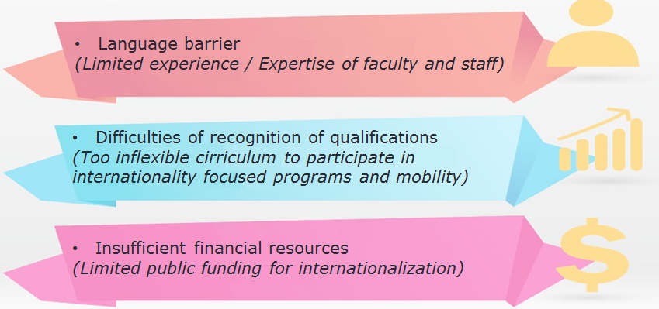
Major obstacles to making it happen
_______________________________________________________________
Source: Internationalization of Higher Education Growing expectation, fundamental values – IAU 4th Global Survey 2014 Eva Egron Polak and Ross Hudson & CCYK-MEN 2013. Study on the Internationalization of Higher Education in Colombia and Modernization of Internationalization Indicators National System of Higher Education (SNIES)

Slide 5






Trends and Challenges
________________________________________________________________
Internationalisation policy – strategies unification-coordination of all the stakeholders
Human factor: Increase and training faculty / staff in the coordination and development of internationalisation processes
Strengthening common regional areas of education
Generating conditions for internationalisation of higher education – Mutual recognition agreements, legal framework
Development new teaching methodologies - virtual education - ICTs
Promoting Colombia as a destination for higher education and Spanish
Source: COUNTRY REPORT FOR COLOMBIA in “Internationalization of Higher Education”; European Parliament, Centre for Higher Education Internationalization at Cattolica University in cooperation with IUA & EAI, Kelly Henao & Jeannette Velez 2014. Ministerio de Educación Nacional Colombia – MEN & Observatorio de internacionalización de la educación superior – Universidad del Rosario

Slide 6
Trends and Challenges
________________________________________________________________
Strengthen capacities of the stakeholders and the HEI
Implementation of a language policy
Creation of an agency that promotes the international education and the research
Generating conditions for internationalisation of higher education financial, infrastructure the candy
WAKING ALL TOGETHER !!!
Source: COUNTRY REPORT FOR COLOMBIA in “Internationalization of Higher Education”; European Parliament, Centre for Higher Education Internationalization at Cattolica University in cooperation with IUA & EAI, Kelly Henao & Jeannette Velez 2014. Ministerio de Educación Nacional Colombia – MEN & Observatorio de internacionalización de la educación superior – Universidad del Rosario

Slide 7

2.1 CCYK ®
To present our best practice (initiative born in HEI’s) + transformatives alliances.
  How did we promote quality Higher Education in Colombia
  How did we become a Network

Slide 8

Colombia - Challenge Your Knowledge® -CCYK
is a network of 20 Colombian Accredited Universities to promote COLOMBIA as a destination for academic and scientific collaboration.
To promote COLOMBIAN research, academic programs and initiatives
Objectives
To strengthen academic internationalization of CCYK members
To study current trends in internationalization of Higher Education
CCYK promotes active collaboration between Colombian Universities with worldwide HEI´s:
Serves as a platform for strategic networking
Shares the information about projects and initiatives
Presence in international conferences

Slide 9

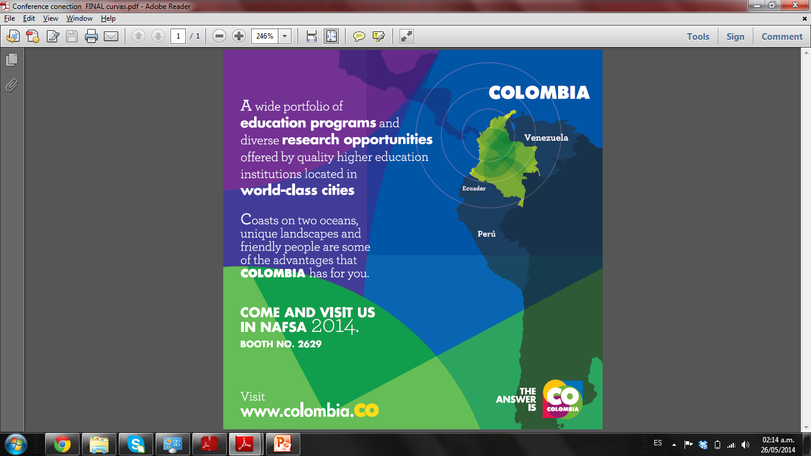
Brazil
Brazil

Slide 10

CCYK Figures
5,000
academics
with PhD
330,000
students
2,200
research
groups
29,000
academics

Slide 11
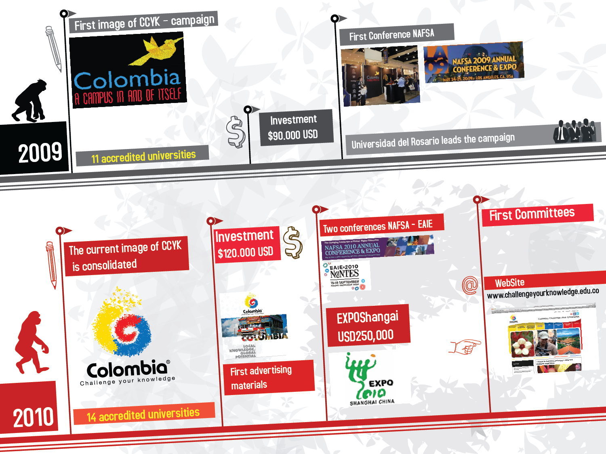

Slide 12
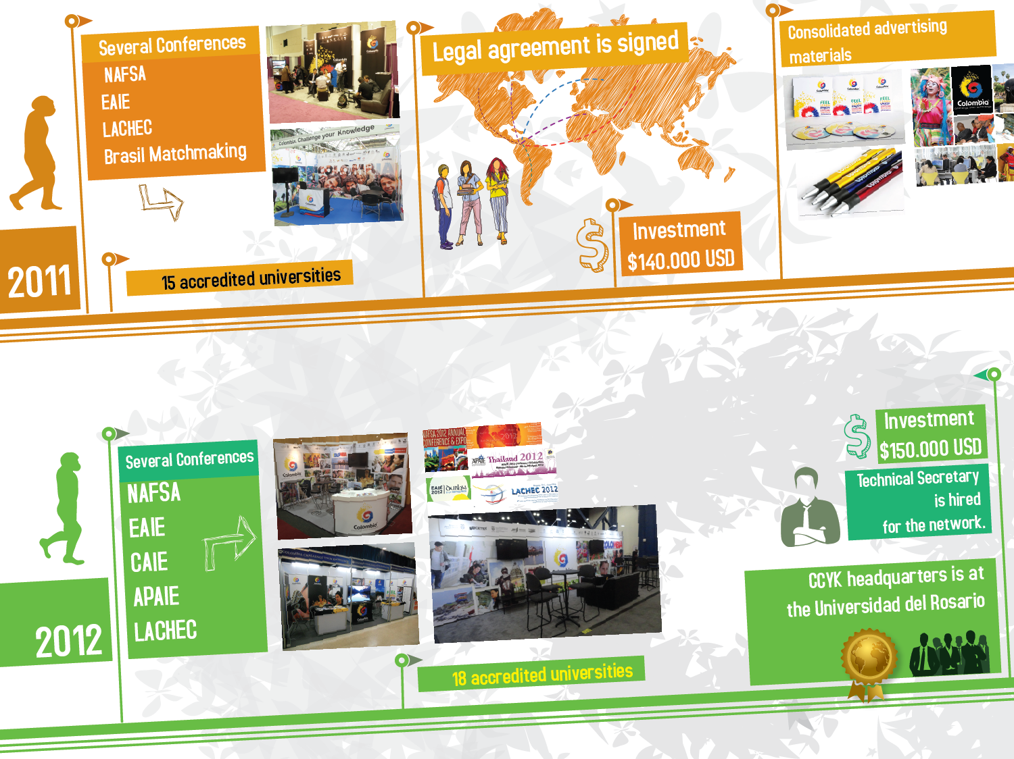

Slide 13
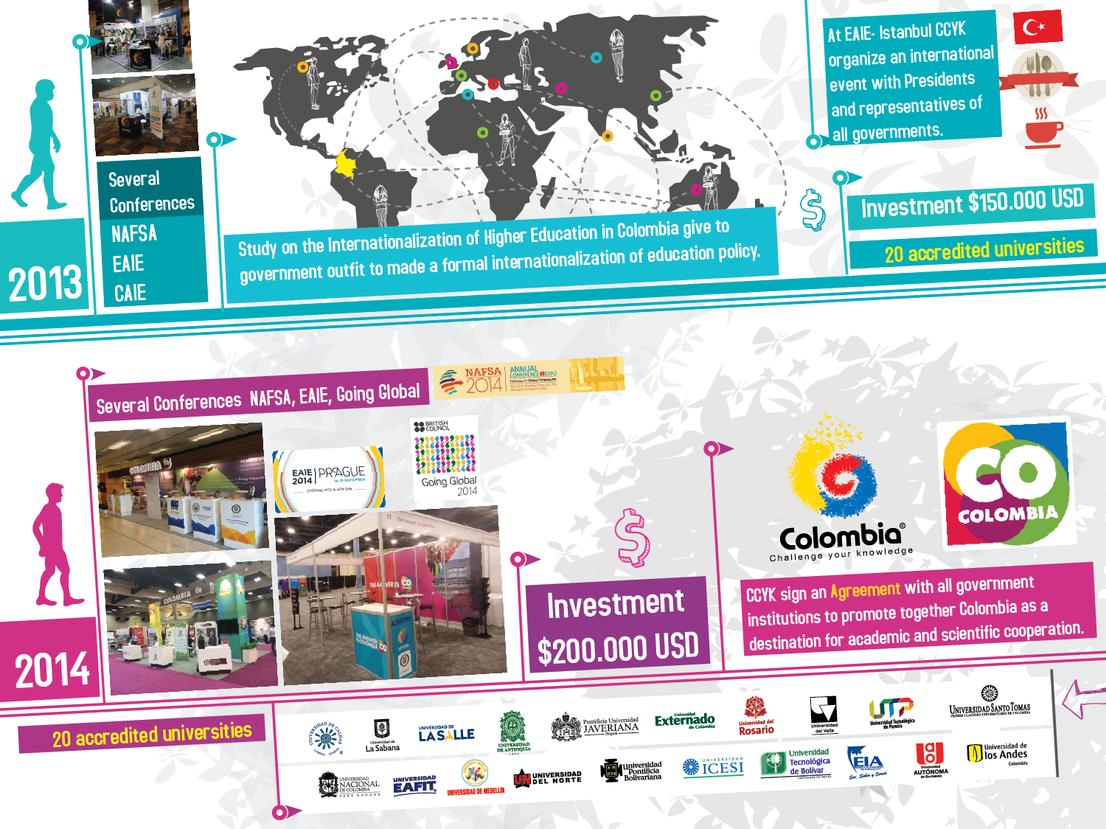

Slide 14
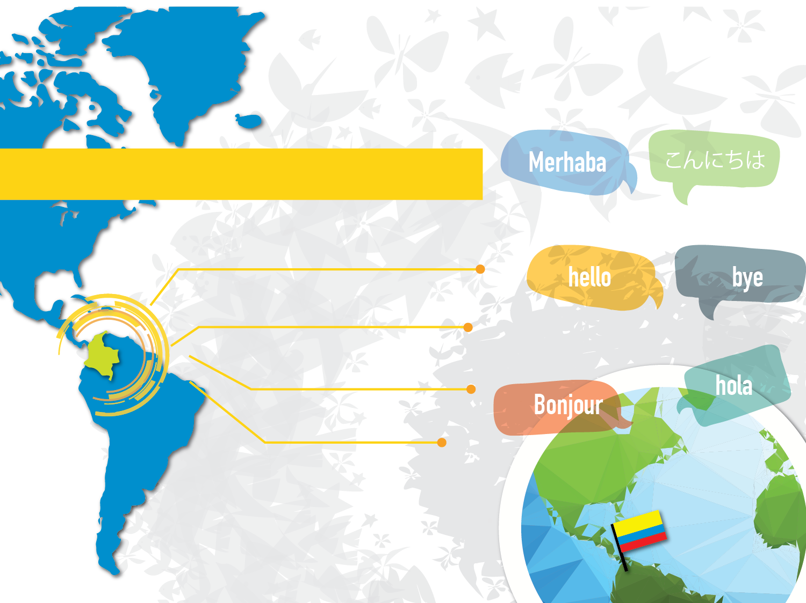
Impact on the Higher Education
of the country
National study about Internationalization
of Higher Education in Colombia.
Publication of reflexions to support the
internationalization process.
Accompanying program to universities
in quality accreditation process.
Special program to promote the
Spanish by regions.

Slide 15

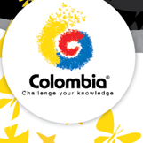

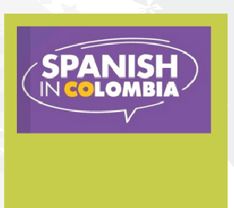
Impact on education and culture within the country - Colombia
Synchronization of national agendas
Migration policy
Education brand
Spanish in Colombia
Bilingualism Policy

Slide 16

Colombia as an international campus
Quality assurance system in higher education: international partnership and international accreditation ➔
Academics
Researchers (U$ 200 MM Colciencias)
Students (6.000 scholarships from 2015 to 2018)

Slide 17

RESEARCH
Today topics with fundraising priority:
Peace and post-conflict processes
Food security
Climate change
Biodiversity management
Sustainable and social development
Medicine – tropical disease
Agriculture – agroindustry
SUPPORT OPPORTUNITIES – companies
COLCIENCIAS
BANCOLDEX
ICETEX
PLANEACIÓN NACIONAL
  Lines
  Regional strategies
  Rounds
  Revolution of research in product innovation
  Contracts
  Thematic Planning
OTRAS INSTITUCIONES
Embassies, Colfuturo

Slide 18

Good practice
The CCYK Initiative has had an impact on members: the institutions improved their performance indicators as a result of the campaign; Number of Students, double degree agreements etc..
Common problems to solve: Colombia unseen internationally, international ignorance of Colombian education system, low mobility to Colombia, its quality and its research potential,
Global impact: improving quality and visibility of Colombia.
Association of actors on the basis of identification and work together - work alone is impossible (MEN Icetex Pro Colombia, Chancery, Caro y Cuervo)
Development of products and services - Sustainability
Consolidation and transformation into a country campaign, formalization, budget, organizational structure - Shared responsibility
Project new goals for the future

Slide 19

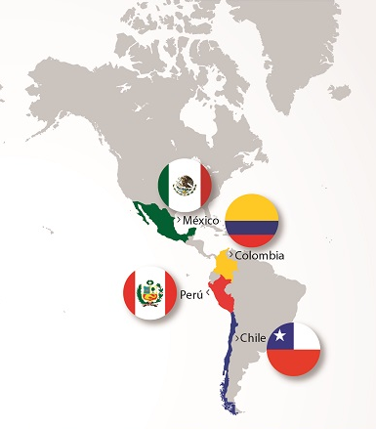

2.2 PACIFIC ALLIANCE
Colombian education perspective

Slide 20

What is the Pacific Alliance?
Mechanism of regional, economic and trade integration.
Between Chile, Colombia, Mexico and Peru.
Established on June 6th, 2012 in a memorandum of understanding
In order to create markets between its members, for increased competitiveness.
Source: http://alianzapacifico.net/

Slide 21
Objectives
To build in a participative and agreeable way an area of deep integration to move progressively towards the free movement of goods, services, capital and people.
To promote growth, development and competitiveness of the economies of the parties, with a view to achieve greater well-being, overcome socioeconomic inequality and foster social inclusion of its inhabitants.
Become a platform of joint political, economic and commercial integration, and projection to the world, with emphasis on the Asia-Pacific region.
Source: http://alianzapacifico.net/

Slide 22
Strengths
The Pacific Alliance is the eighth-largest economy and the eighth largest exporter worldwide.
In Latin America and the Caribbean, the block represents 37% of GDP, concentrated 50% of total trade, attracting 45% of foreign direct investment.
The four countries account for a population of 214 million people and have an average GDP per capita $ 10,000.
The population is mostly young and is a skilled labor force and attractive market with steadily growing purchasing power.
Source: http://alianzapacifico.net/

Slide 23
Members maintain a network of trade agreements among themselves and with the most developed economies in the world
Promotes trade, investment, innovation and technology with the most competitive regions in the world
It has the potential to attract new investment to the region.
The Pacific Alliance has competitive advantages in areas such as mining, forestry, energy, agriculture, automotive, fishing and manufacturing.
FREE TRADE AREA
Source: http://alianzapacifico.net/

Slide 24
Cooperation opportunities, paper of the Universities
Free movement of people
Creating a network of scientific research on climate change
Preservation and environmental friendliness
Opening of sales offices and joint participation in fairs and exhibitions in a single space
Integration of securities markets
Cultural Promotion
Improving the competitiveness and innovation of the Micro, Small and Medium Enterprises
Tourism
Strengthening Relationships between Chile – Peru - Mexico-Colombia
Source: http://alianzapacifico.net/

Slide 25
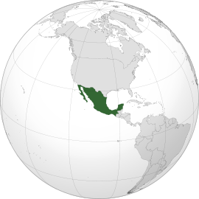
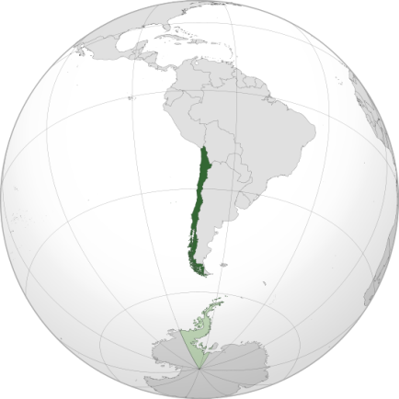
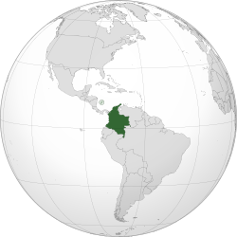
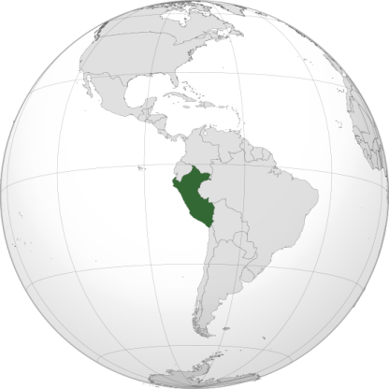
Education in the Pacific Alliance

Slide 26

Best universities according to Shanghai Ranking
Australia 21/500
Canada
20/500
China
32/500
Japan
19/500
Korea
10/500
Singapore
2/500
Chile
2/500
Peru
0/500
Mexico
2/500
Colombia
0/500
Source: Observatorio de Internacionalización de la Educación Superior – Universidad del Rosario

Slide 27

Best universities according to QS. Ranking
Australia 30/500
China
24/500
Japan
16/500
Canada
20/500
Korea
13/500
Singapore
2/500
Colombia
3/500
Chile
3/500
Mexico
2/500
Peru
0/500
Source: Observatorio de Internacionalización de la Educación Superior – Universidad del Rosario

Slide 28

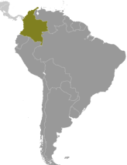
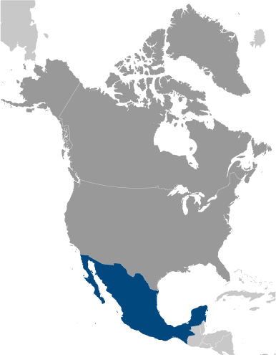
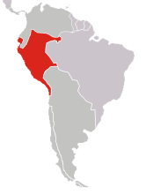
Colombia
Chile
Undergraduate
Duration: 5-7 years
Tittle: Graduate
Postgraduate
Duration Specialization:
Posgraduate
1 year
Duration Master´s: 2 – 3 years
Duration PhD or Docorate:
3 – 5 years
Undergradute
Postgraduate
Duration: 5 year
Tittle: Professional
Postgraduate
Duration
Specialization: 1year
Master´s:
2 years
Duration:
PhD or Doctorate :
5 Years
Mexico
Peru
Undergraduate
Duration: 4,5,6 years
Tittle: Graduate “Licenciado”
Postgradute
Duration Specialization:
1 year
Duration Master´s: 2 years
Postgraduate
Duration PhD or Docorate:
3 years
Undergraduate
Duration: 5 year
Postgraduate
Duration Specialization:
Postgraduate
Duration PhD or Docorate:
Tittle: Graduate
1 year
Duration Master´s: 2 years
3 – 5 years

Slide 29
TECHNICAL COOPERATION GROUP
Three projects have been approved and launched under the cooperation of the Pacific Alliance:
1. Platform of Student Mobility and Academic of the Pacific Alliance
2. Scientific Research Network on Climate Change
3. Synergy between the countries of the Pacific Alliance to improve the competitiveness of micro, small and medium enterprises.
Source: http://alianzapacifico.net/

Slide 30
Platform of Student and Scholar Mobility of the Pacific Alliance
Scholarships by country |  | Call 1 (2013-1) | Call 2 (2013-2) | TOTAL fellows 2013 | Call 3 (2014-1) | Call 4 (2014 - 2) | TOTAL fellows 2014 | Total by type | Total by country
Mexico | Undergraduate | 31 | 35 | 66 | 44 | 40 | 84 | 150 | 176
 | Doctorate/Research/Staff Movility | 1 | 9 | 10 | 6 | 10 | 16 | 26
Chile | Undergraduate | 30 | 46 | 76 | 56 | 0 | 56 | 132 | 157
 | Doctorate/Research/Staff Movility | 6 | 5 | 11 | 14 | 0 | 14 | 25
Colombia | Undergraduate | 15 | 34 | 49 | 19 | 68 | 87 | 136 | 150
 | Doctorate/Research/Staff Movility | 1 | 3 | 4 | 3 | 7 | 10 | 14
Peru | Undergraduate | 9 | 26 | 35 | 41 | 53 | 94 | 129 | 138
 | Doctorate/Research/Staff Movility | 0 | 3 | 3 | 2 | 4 | 6 | 9
CALLS TOTAL |  | 93 | 161 | 254 | 185 | 182 | 367 | 621
GENERAL TOTAL (Calls 1, 2, 3 y 4) |  | 621
Source: http://alianzapacifico.net/

Slide 31




It is the institution responsible for the procedures for awarding grants of Pacific Alliance in Colombia.
It is the institution responsible for the procedures for awarding scholarships pf Pacific Alliance in Chile.
It is the institution responsible for the procedures for awarding scholarships pf Pacific Alliance in Mexico.
It is the institution responsible for the procedures for awarding grants of Pacific Alliance in Peru.

Slide 32
Areas – Pacific Alliance Scholarships
Business.
Finance.
International trade
International relations
Public administration
Political science
Business administration
Science and technology
Engineering
Exact sciences
Economy
Environment
Climate change
Social and human sciences
Science and technology
Tourism
Other areas related to cooperation projects carried out in the framework of the Group technical of cooperation - GTC (gastronomy, sports and culture), as well as others relating to innovation, science and technology that conform to the objectives of the Pacific Alliance linked to commercial or international relations.
Source: Amexcid, ICETEX, AGCI, PRONABEC

Slide 33
Synergy between the countries of the Pacific Alliance to improve the competitiveness of small and medium size enterprises
It is aimed at institutional strengthening and management to improve competitiveness and innovation between Chile, Colombia, Mexico and Peru, through an exchange of knowledge and experiences in four workshops in the areas of: business competitiveness, business development, monitoring and impact assessment of programs and projects within small and medium size enterprises.
Source: http://alianzapacifico.net/

Slide 34
New agreement
Cooperation Fund of the Pacific Alliance
Environment and climate change
Innovation, Science and Technology
Micro, Small and Medium Enterprises
Social Development
Currently, this document follows the internal ratification procedures for Chile, Peru and Colombia for its entry into force.
Source: http://alianzapacifico.net/

Slide 35
Achievements in education
1. Technical Group of Education!!! 2015
2.Countries understand the need to promote the internationalization of the future entrepreneurs of the Pacific Alliance and the need to perceive the Alliance as a single market full of opportunities.
3. Countries granted first semester of 2015l 204, undergraduate scholarships (49 for Colombians). The idea is to have professionals who know first-hand the markets of CH, MX, PE and know how to use them from Colombia.
4. Development of the network for scientific research on climate change.
Source: http://alianzapacifico.net/

Slide 36
GTE
Technical Education Group aims to strengthen the ties of educational integration through cooperation, aimed at improving the skills and capacities of the population of the member countries and their access to quality education as essential tools for the development of human capital and to boost productivity and competitiveness of the countries of the Pacific Alliance.

Slide 37
Regional initiatives on educational cooperation
AUALCPI “Association of Universities of Latin America and the Caribbean for Integration”
IESALC “International Institute for Higher Education in Latin America and the Caribbean”
RLCU “Latin American Network of University Cooperation”
OUI-IOHE “Inter-American Organization for Higher Education”
COLUMBUS
ReLARIES “Latin American and Caribbean Network of International Relations Institutions”
Source: http://alianzapacifico.net/

Slide 38
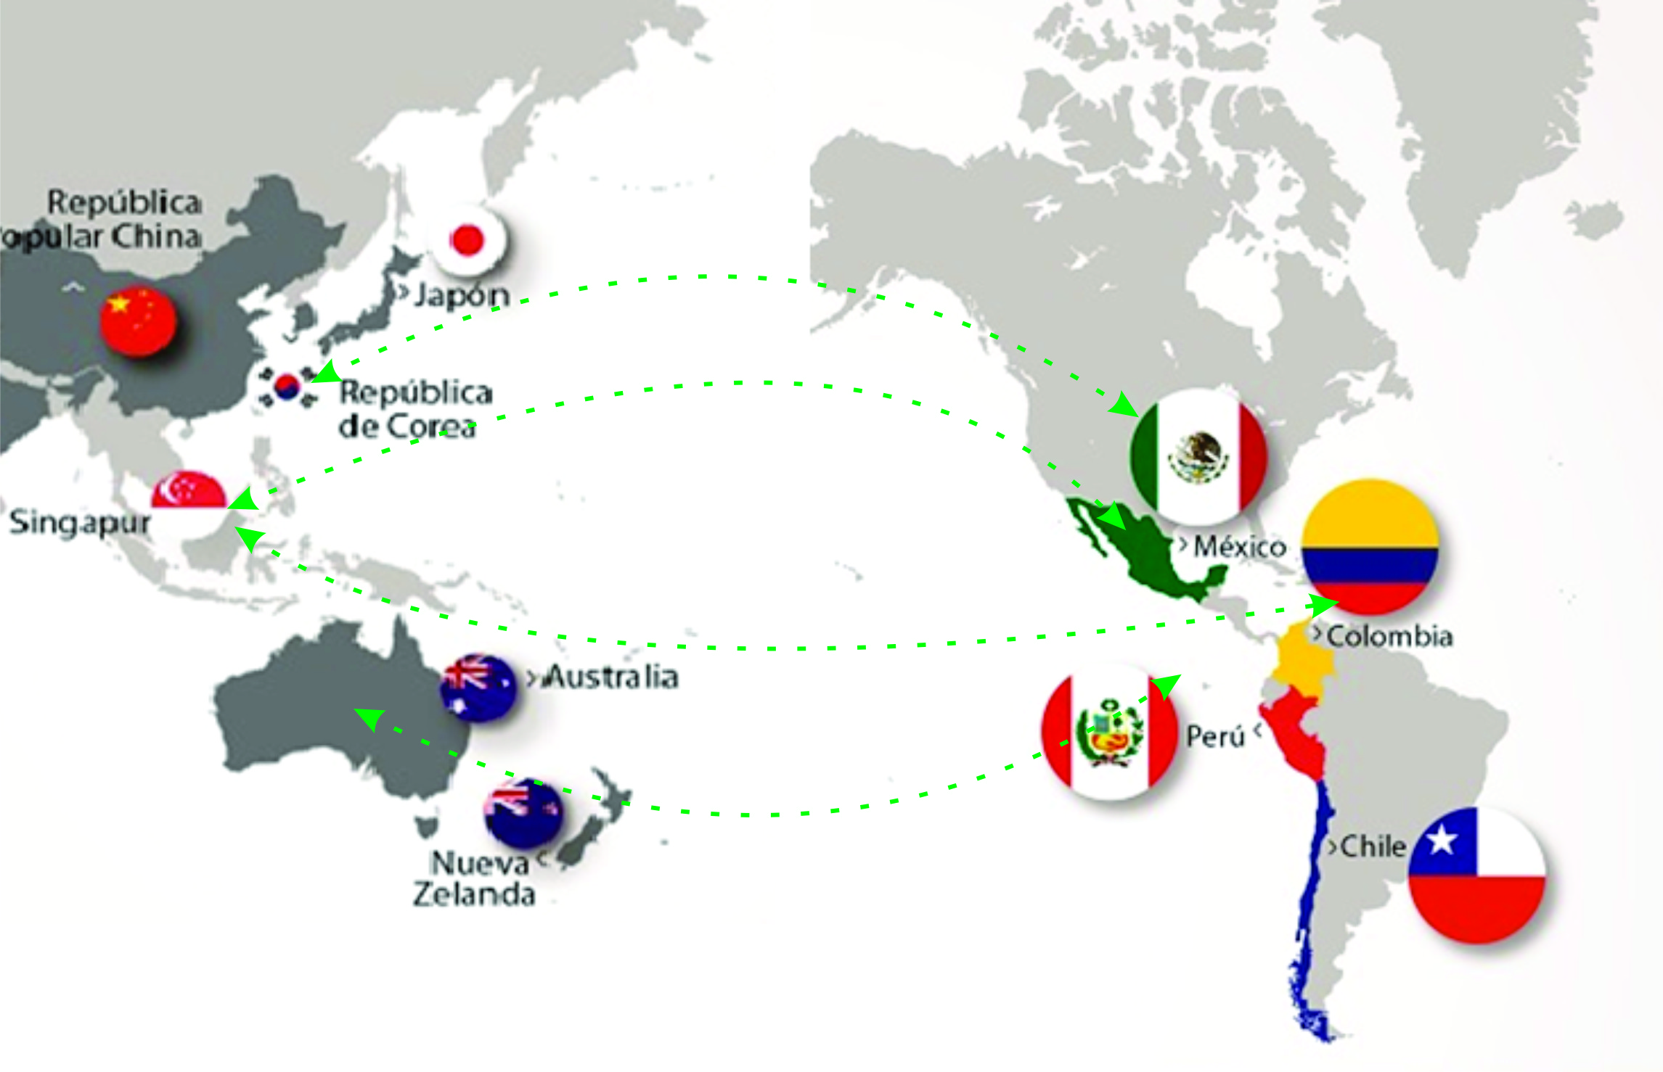
Pacific

Slide 39
Canada | Australia | China | Korea | Japan | Singapore
20 University of Toronto 21 McGill University 43 University of British Columbia 83 Université de Montréal 84 University of Alberta 113 McMaster University 169 University of Waterloo 171 University of Calgary 187 Queen's University, Ontario 191 Western University 218 University of Ottawa 222 Simon Fraser University 235 Dalhousie University 290 University of Victoria 298 Laval University 421-430 York University 431-440University of Guelph 441-450 Université de Sherbrooke 461-470 Concordia University 481-490 University of Saskatchewan | 25 The Australian National University 33 The University of Melbourne 37 The University of Sydney 43 The University of Queensland 48 The University of New South Wales 70 Monash University 89 The University of Western Australia 92 The University of Auckland 100 The University of Adelaide 159 University of Otago 242 University of Canterbury 254 Macquarie University 257 The University of Newcastle, Australia (UoN) 264 University of Technology, Sydney 275 Victoria University of Wellington 283 University of Wollongong 285 QUT 304 Royal Melbourne Institute of Technology 324 Griffith University 331 Curtin University 333 University of South Australia 346 Massey University 350James Cook University 360 Deakin University 401-410 La Trobe University 401-410 University of Tasmania 401-410 University of Waikato 411-420 Lincoln University 471-480 Bond University 481-490 Flinders University | 28 The University of Hong Kong 40 The Hong Kong University of Science and Technology 46 The Chinese University of Hong Kong 47 Tsinghua University 57 Peking University 71 Fudan University 104 Shanghai Jiao Tong University 108 City University of Hong Kong 144 Zhejiang University 147 University of Science and Technology of China 162 Nanjing University 162 The Hong Kong Polytechnic University 240 Beijing Normal University 318 Hong Kong Baptist University 321 Sun Yat-sen University 328 Nankai University 335 Wuhan University 379 Xi'an Jiaotong University 393Tongji University 441-450 Xiamen University 451-460 Beihang University (former BUAA) 461-470 Renmin (People’s) University of China 481-490 Harbin Institute of Technology 481-490 Huazhong University of Science and Technology | 31 Seoul National University 51 KAIST - Korea Advanced Institute of Science & Technology 86 Pohang University of Science And Technology (POSTECH) 106 Yonsei University 116 Korea University 140 Sungkyunkwan University 219 Hanyang University 275 Kyung Hee University 355 Ewha Womans University 384 Sogang University 431-440 Pusan National University 441-450 Chung-Ang University(CAU) 481-490 Hankuk (Korea) University of Foreign Studies | 31 The University of Tokyo 36 Kyoto University 55 Osaka University 68 Tokyo Institute of Technology 71 Tohoku University 103 Nagoya University 126 Kyushu University 135 Hokkaido University 197 Keio University 198 University of Tsukuba 220 Waseda University 294 Kobe University 294 TMDU 314 Hiroshima University 441-450 Tokyo Metropolitan University 491-500 Chiba University | 22 National University of Singapore 39 Nanyang Technological University (NTU)

Slide 40
 | China | Japan | Australia | Korea
Grading Scale | 0,0 -100 *60 F – A *P 2 -5 *3 | F - A *C 0 - 10 *4 | P – HD *P (Pass) 0 – 10 * 5,5 | A – D *D 0 – 5 *2
Types of Institutions | Universities Research Institutes specialized Agencies Independent schools (since 2008) Professional military institutions Colleges and Schools of Medicine Executive Training Schools | Universities Colleges of Technology Specialized training colleges Junior colleges School of graduate studies | UniversitiesTechnical Centers(TAFE) | Universities Technical University University Communication and dissemination Professional University University education Industrial University
Undergraduate degree and duration | Higher Education 2-3 years (Racing mostly vocational-technical nature) Higher Education 4 years (bachelor) | Bachelor degree 4-6 | Bachelor degree 3-4 | Bachelor degree 4
Graduate degree and duration | Master´s degree 2-3 years Doctoral degree 3 years | Master´s degree 2-3 years Doctoral degree 5 years | Master's degree 1-2 years Doctoral degree 3-5 years | Master´s Degree 2-3 years Doctoral degree 2-3 years
Public and private institutions |  | 726 Universities 87 National universities 86 Publics Universities 553 Private Universities | 40 Universities 37 Publics 3 Private | 411 Universities

Slide 41

Pacific Alliance as an education hub?
Be recognized as a center of education excellence and economic activities

Slide 42
What is an education hub?
The term education hub is being used by countries that are trying to build a critical mass of local and foreign actors—including students, education institutions, companies, knowledge industries, science and technology centers—which, thorough interaction and in some cases colocation, engage in education, training, knowledge production, and innovation initiatives. It is understood that countries have different objectives, priorities, and take different approaches to developing themselves as reputed centers for higher education excellence, expertise, and economy.
Source: Higher Education Hubs – International Higher Educations- The Boston College Center for International Higher Education, Jane Knihgt

Slide 43
Main characteristics
Location:
Engagement:
Impact:
Geographical area ( e.g , strategy of recruitment, research)
Types of actors involvement (Local, regional, national, privet and public and international)
Improvement of social, economic and education indicators.
Activities:
Crossborder activities and internationalization at home activities basadas en la definicion de prioridades de trabajo
Source: Higher Education Hubs – International Higher Educations- The Boston College Center for International Higher Education

Slide 44
How to create an education hub?
Level 1
National planing and policies
Level 2
Connections among the actors and initiatives (common economic zone, mobility strategies, partnerships and joint academic programs).
Source: Higher Education Hubs – International Higher Educations- The Boston College Center for International Higher Education Jane Knight

Slide 45
TYPES
Student hub
Talent or skilled workforce hub
Knowledge and innovation hub
Source: Higher Education Hubs – International Higher Educations- The Boston College Center for International Higher Education Jane Knight

Slide 46

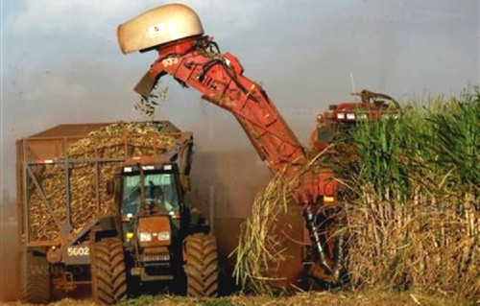


AGREEMENTS P.A.
More than 10 agreements between countries of PA
Liberal professions
Validation and recognition of qualifications
Regional Convention of Studies, Diplomas and Degrees in Higher Education in Latin America and the Caribbean

Slide 47

Agreements A.P – Asia Pacific
Mexico and China: Agreement of mutual recognition of certificates of studies, titles and academic degrees between the United States of Mexico and the People's Republic of China, signed in the city of Mexico the July 30th , 2010.
Australia and Colombia: Memorandum of understanding between the Government of Australia and the Government of Colombia on cooperation in the field of education and training. Signed on 6th August 2002.
Colombia and Korea: Facilitate collaboration among the parties to develop information and communication technologies for the Colombian education.
Colombia and Japan: Agreement of technical cooperation between the Government of Japan and the Government of Colombia. Bogota, December 22nd , 1976.
Colombia and China: Promote and develop scientific and technical cooperation between the two States. Cultural agreement between the Republic of Colombia and the people's Republic of China. Beijing, October 1st , 1981.
Peru has agreements of reciprocity in recognition of foreign qualifications in higher education, with the following countries: Argentina, Bulgaria, Bolivia, Colombia, Costa Rica, Cuba, Chile, China, Ecuador, El Salvador, Spain, Guatemala, Honduras, Hungary, Mexico, Nicaragua, Panama, Paraguay, Romania, Uruguay, Venezuela, Holy See and Ukraine.

Slide 48
Accreditation system
Acreditation | Colombia | Chile | Peru | Mexico
Accreditation Board for Engineering and Technology - ABET | 15 | - | 1 | -
Accreditation Council for Business Schools programs - ACBSP | 7 | - | 2 | 3
CLAEP | 5 | 3 | 2 | 4
RIACES | 4 | 3 | 2 | 4
UDUAL | 29 | 3 | 24 | 64
Asociación Universitaria Iberoamericana de posgrado - AUIP | 2 | 5
Association of MBAs | 1 | 7 | 3 | 4
Association to Advance Collegiate Schools of business | 1 | - | - | -
Commission on English Language Program Accreditation - CEA | 1 | - | 2 | -
European Foundation for Management Development – EFMD Quality Improvement System - EQUIS | 1 | - | - | -
Source: Estudio CCYK-MEN

Slide 49
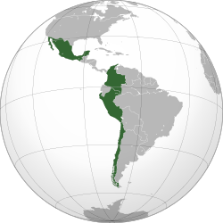

Research Areas - PA
PERU
Medicine
Biodiversity
Raw Materials
Biology and Biochemistry
Engineering
Administration
Law
Environment
Technology
Culture and Communication
Economy
Source: CONCYTEC
MEXICO
Raw Materials
Biochemistry and Biotechnology
Studies on management and conservation of natural resources
Health, education and culture
Medical Biomechanics
Engineering
Advanced Technology
Law and social sciences
Applied Sciences
Environment
Medicine
Source: CONACYT
COMMON AREAS
Medicine
Raw Materials
Engineering
Environment
Natural Resources
Technology
Law
Biomedical
Economy
Applied Sciences
Culture
Social Sciences
Energy
COLOMBIA
Business
Economy
Marketing
Law
Psychology
Energy
Biomedical engineering
Climate change
Mineral resources
Medicine
Innovation Entrepreneurship
Anthropology
Political Sciences
Source: COLCIENCIAS
CHILE
Natural Sciences
Social Sciences
Humanities
Engineering and Technology
Economy
Environment
Natural Resources
Source: CONICYT
Source: Observatorio de Internacionalización de la Educación Superior – Universidad del Rosario

Slide 50

DOUBLE DEGREES
6%
4%
12%
60%
50%
Source: Observatorio de Internacionalización de la Educación Superior – Universidad del Rosario

Slide 51
Centers of Excellence in Research accredited by COLCIENCIAS
1. Tuberculosis: La investigación integrada a la Salud Pública para mejorar su control CCITB
2. Centro Nacional de Investigaciónes para laAgroindustrialización de especies vegetales aromáticas
medicinales tropicales CENIVAM
3. Centro de Investigacion y Estudios en Biodiversidad y Recursos Genéticos CIEBREG
4. Centro de Nuevos Materiales CENM
5. Centro de Excelencia en Modelamiento y Simulación de Fenómenos y Procesos Complejos
6. Observatorio Colombiano para el Desarrollo Integral, la Convivencia Ciudadana y el Fortalecimiento Institucional en Regiones Fuertemente Afectadas por el Conflicto Armado
Centro de Investigación en Ciencias del Mar CEMARIN
In this link, the characteristics of each one: http://www.colombiaaprende.edu.co/html/investigadores/1609/fo-article-114986.pdf

Slide 52
Opportunities and challenges
To expand relations with Asia Pacific, with the goal of exploring new markets, that increase the competitiveness of the Alliance countries.-Technological parks
To move forward on issues of regional integration in the field of education to position Pacific Alliance as a hub of education – a first step for a common education space.
Take on the opportunity to improve the education structures of our countries with high quality and inclusive programs, focusing in developing and strenghtening research capacities with impact in knowledge generation and innovation.
To deepen the Exchange and student recruitment in the countries of the Pacific, within a quality and inclusion driven approach.
Develop agreements of mutual recognition of qualifications in order to obtain a greater circulation of people sustained, very importantly, by reform measures that facilitate employability.
Generate double degrees with countries of the Asia- Pacific.
Relieve the importance of technical education in partner countries and include technical institutions as key actors for employability.
Develop broad, inclusive language training programs including Asia-Pacific languages.
Source: Observatorio de Internacionalización de la Educación Superior – Universidad del Rosario

Slide 53

Thanks!!!
Jeannette Velez R.
Chancellor – International Affairs
Universidad del Rosario
PBX. +571- 2970200 – 2123/2120 jeannette.velez@urosario.edu.co www.urosario.edu.co

